Slide 1

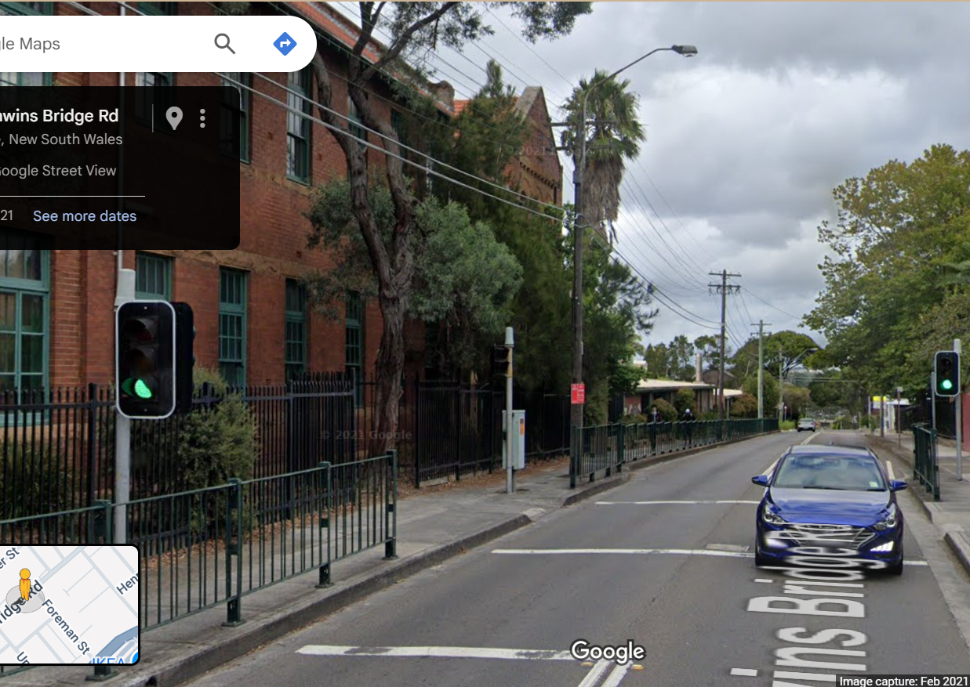
Pi Pico OOP Mini Project
Ben Jones
Tempe High School
Lecture 3

Slide 2
Today
Abstraction
Implement a non blocking flash method
Complete and Unit Test led light Class
Notes:
Today we will

Slide 3
Simple Open Loop Control System
Traffic Lights remain green until pressed (idle state).
Button pressed triggers state change.
Lights rotate through a pattern based on time.
System returns to idle state

Slide 4
Abstraction
Abstraction in Object-Oriented Programming (OOP) is a principle that focuses on exposing only the essential features of an object while hiding the unnecessary details. The primary goal is to offer a simplified, high-level interface for interacting with complex systems, thereby making your code easier to use and understand.
- What vs. How: Abstraction tells you what an object does, not how it does it.
- Simplification: It reduces complexity by hiding implementation details.
Interface: Abstraction is often achieved by hiding the complex implementation and providing only the interface methods or attributes.

Slide 5
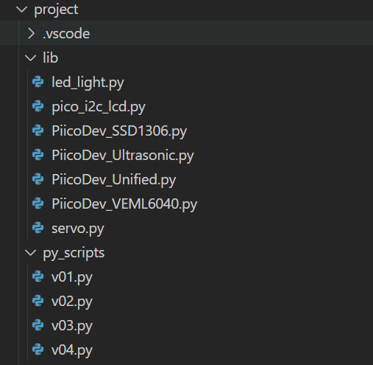
Create new files
v04.py in project\py_scripts\
led_light.py in project\lib\
Then copy the relevant imports and Class to led_light.py

Slide 6

Test the abstraction
from project.py_scripts.LL_unit_Test import Led_Light
from time import sleep
red_light = Led_Light(3, True, True)
while True:
print(red_light.led_light_state)
red_light.led_light_state = 1
sleep(0.25)
print(red_light.led_light_state)
red_light.led_light_state = 0
sleep(0.25)

Slide 7
Add a led_light_state attribute
Class Led_Light(Pin):
# Sub Class inherits the Super 'Pin' Class
def __init__(self, pin, flashing=False, debug=False):
super().__init__(pin, Pin.OUT)
self.led_light_state
self.__debug = debug
self.__pin = pin
self.__flashing = flashing
self.__last_toggle_time = time()

Slide 8
Create a .flash() method
def flash(self):
# Non-blocking flash: toggles LED every 0.5s for the given duration
now = time()
if self.__flashing and now - self.__last_toggle_time >= 0.5:
self.toggle()
self.__last_toggle_time = now

Slide 9
Test the non blocking .flash() method
red_light = Led_Light(3, True, True)
while True:
red_light.flash()
sleep(0.1)

Slide 10
Unit Test the Led_Light Class
Your unit test should test all methods, where possible, using the self.value() method to automate the test if possible.
Pause the video, design your unit test, then check your unit tests against my suggested batch of unit tests.

Slide 11

Add documentation to your Class
Class LedPico:
"""
Simple Class to turn an LED on or off on a Raspberry Pi Pico.
Args:
pin (int): GPIO pin number for the LED.
Example:
led = LedPico(25) # Onboard LED
led.set(True) # Turn on
led.set(False) # Turn off
"""
def __init__(self, pin):
from machine import Pin
self.led = Pin(pin, Pin.OUT)
def set(self, state: bool):
"""
Set the LED on or off.
Args:
state (bool): True to turn on, False to turn off.
"""
self.led.value(1 if state else 0)
Class-level docstring: Briefly describes what the Class represents and lists its attributes and methods.
Constructor docstring: Explains what parameters are needed to create an instance.
Method docstrings: Describe what each method does and what parameters it takes.
Notes:
Using this example as a template write developer documentation
For your Led Light Class
Your documentation should describe the purpose/why
not the implementation/how
“Turn the LED on.
Overrides the Pin.on() method to provide additional debug output.”
is good documentation As it describes the purpose of method
Compared to
“Set pin high or low” is poor documentation
As it just states what the method does
Which is unessessary as it can be understood by reading the method

